Slide 2
Hybrid Cloud
Increasing Business Value with Cloud-optimized IT
Damir Bersinic
MTC Architect
damirb@microsoft.com

Slide 3
Microsoft Azure
57%
of Fortune 500 companies signed up for Microsoft Azure
300k+
customers, adding 10,000/week
1M+
Microsoft Azure SQL databases
30T+
storage objects in Microsoft Azure
250k+
active websites hosted on Azure
2x
compute and storage growth every 6 months
18B+
weekly Microsoft Azure Active Directory authentications
2M+
developers registered with Visual Studio Online
Innovation at global scale

Slide 4

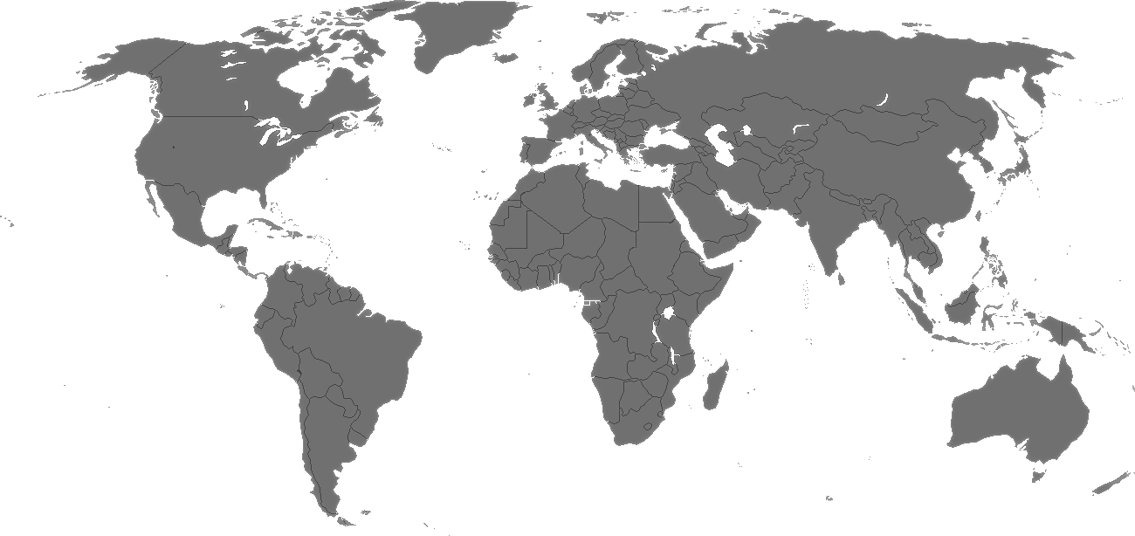

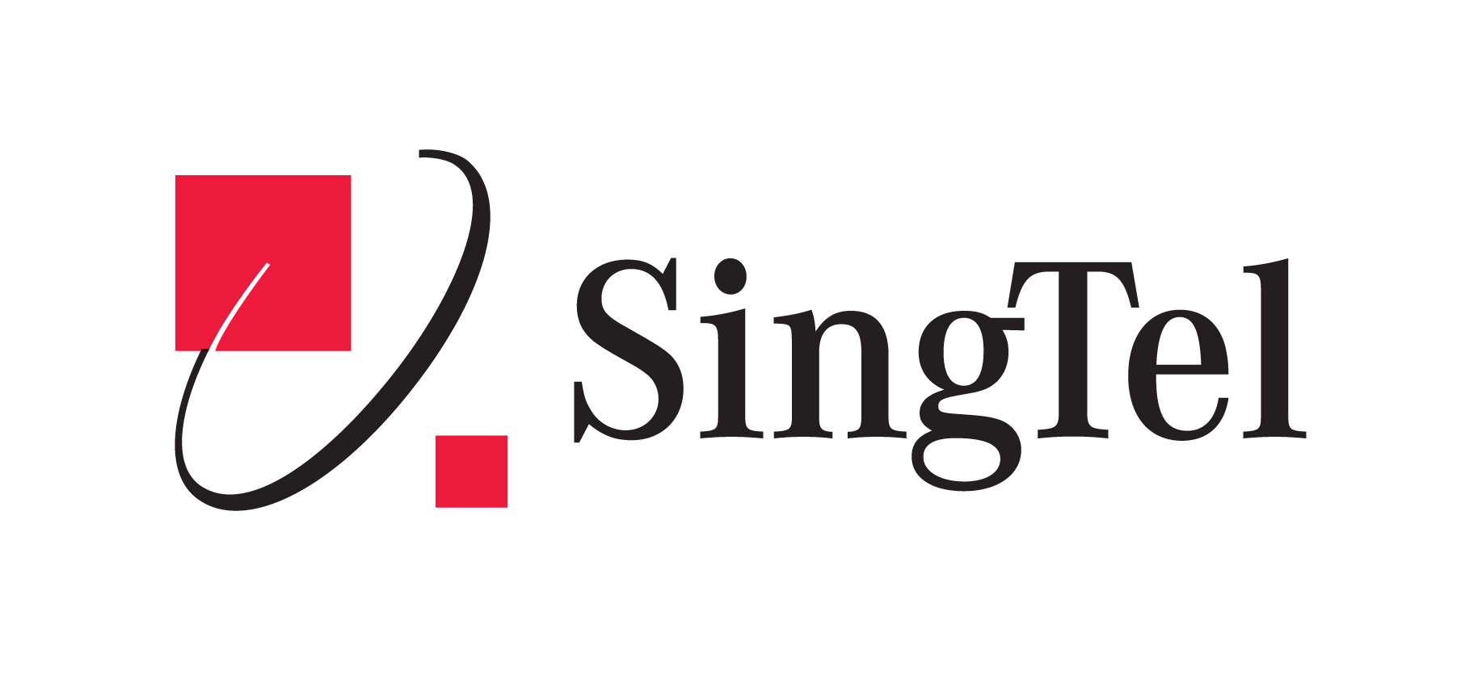










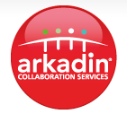
























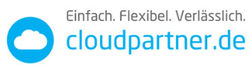



































Microsoft cloud platform
World-class partners. Local experts. Customized cloud.
100+
world-class partners
600+
local datacenters
3.7M
customers
100+
countries
Azure datacenter
Cloud OS Network partner HQ
COSN Silver & Bronze partner

Slide 5

Microsoft cloud platform
The platform for hybrid cloud enables IT to:
Customer
Empower enterprise mobility
Create the Internet of your things
Enable application innovation
Unlock insights on any data
Transform the datacenter
CONSISTENT PLATFORM
Service Provider
Microsoft
Development
Management
Identity
Data
Virtualization

Slide 6
Azure innovation everywhere
Datacenter
Microsoft Azure
Services
Azure Pack
Services
Consistency
Connectivity
Code
Infrastructure
System Center
Windows Server
Hyper-V
Infrastructure

Slide 7
Transform the datacenter
Build a
software-defined foundation
Automate and secure your infrastructure
Extend
to the cloud
on demand
Microsoft Azure Windows Server Microsoft System Center

Slide 8
Cloud-inspired infrastructure foundation
Provisioning and operations
Management plane
Provisioning and operations
Provisioning and operations
Control plane
Compute cluster
Network controller
Storage cluster
Data plane
Virtual machines
Virtual networks
File servers
Standard APIs
Standard APIs
Standard APIs
Compute
Industry-standard servers
Networking
Physical network
Storage
Industry-standard disks

Slide 9
Cloud-inspired infrastructure foundation
Provisioning and operations
Provisioning and operations
Provisioning and operations
Compute cluster
Network controller
Storage cluster
Virtual machines
Virtual networks
File servers
Standard APIs
Standard APIs
Standard APIs
Compute
Industry-standard servers
Networking
Physical network
Storage
Industry-standard disks

Slide 10
Transform the datacenter
Build a
software-defined foundation
Automate and secure your infrastructure
Extend
to the cloud
on demand
Microsoft Azure Windows Server Microsoft System Center

Slide 11

Unified management
Manage
Operate
Provision
Simplify cloud management with consistent processes
Infrastructure, workload, and application monitoring
Cloud and workload deployment and configuration
Automate
Automating IT operations and standardized best practices

Slide 12

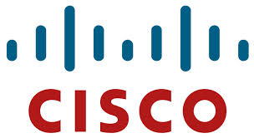
FlexPod
Microsoft Hybrid Cloud & The NetApp Cloud Data Fabric

Slide 13






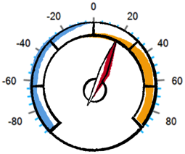



The Need for Seamless Cloud Services
Cloud Service Providers
Hyperscale Cloud Providers
Private
Public
Private Cloud

Slide 14


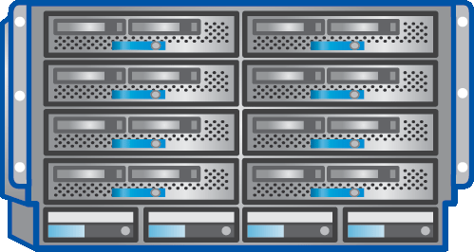

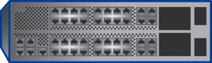

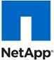

FlexPod Datacenter with Microsoft Private Cloud
Microsoft Private Cloud Fast Track 4.0 Validated
Converged infrastructure platform: With deep integration with Windows Server® 2012 R2 and System Center 2012 R2
Reduced risk: Prevalidated hardware to accelerate and simplify deployment
Lower cost: Compute, network, storage, and private cloud in a turnkey platform
Accelerated virtual machine (VM) deployment with offloaded data transfer for ultrafast cross-protocol file transfer VMs in minutes
Windows® Azure Pack for service provider–ready self-service portals
High availability (HA) from hardware layer to fabric management, no single point of failure
Learn more
www.netapp.com/microsoftsolutions
www.cisco.com/go/microsoft
FlexPod with Microsoft Private Cloud NVA
Cisco UCS® blade and rack servers and UCS® Manager
Cisco Nexus® family switches including N1000V
NetApp® FAS
storage systems
* NetApp 50% Storage Guarantee http://www.netapp.com/us/solutions/infrastructure/virtualization/guarantee.html

Slide 15

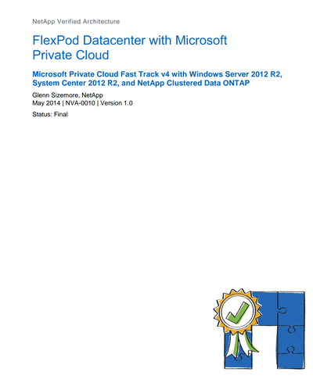
FlexPod with Microsoft Private Cloud
Designed, tested, and documented by NetApp and Cisco
Validated by Microsoft® Private Cloud Fast Track v4
Documented deployment and configuration of:
Physical cabling
Compute and storage
Windows Server® Hyper-V® and System Center
Cisco® and NetApp® software management components
FlexPod Datacenter with Microsoft Private Cloud NVA

Slide 16
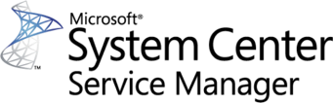

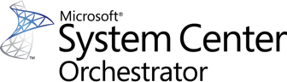
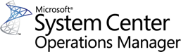










FlexPod Integration for Microsoft
Administration
CMDB: Fabric State
UI: Initiate workflows
Sample scripts
Orchestration
End-to-end workflows
Data ONTAP PowerShell Toolkit
Cisco UCS SCO Integration Packs
Management
Data ONTAP SCOM MP
Data ONTAP SCVMM Pro Tip Cisco UCS SCOM MP
Cisco UCS SCVMM GUI Add-in
Manage processes and operations
Automation
Centralized automation and configuration
Data ONTAP PowerShell Toolkit
Cisco UCS PowerTools
Windows PowerShell
Virtualization
SnapDrive for Windows
SnapManager for Hyper-V
Cisco VM-Fex/Nexus 1000v
Virtualization and resource pools
Hardware
Data ONTAP
Cisco UCS
Cisco Nexus
Management and provisioning
WS-Man PowerShell SMI-S Interfaces

Slide 17




Putting It All Together
App Controller
Virtual Machine Manager (VMM)
Library Server
Service Manager – Self-Service Portal (SSP)
Host Cluster
Storage Pools
SMI-S
Data ONTAP®
Windows® Azure Pack Tenant Portal
VMware vSphere®
Hyper-V®
XenServer

Slide 18



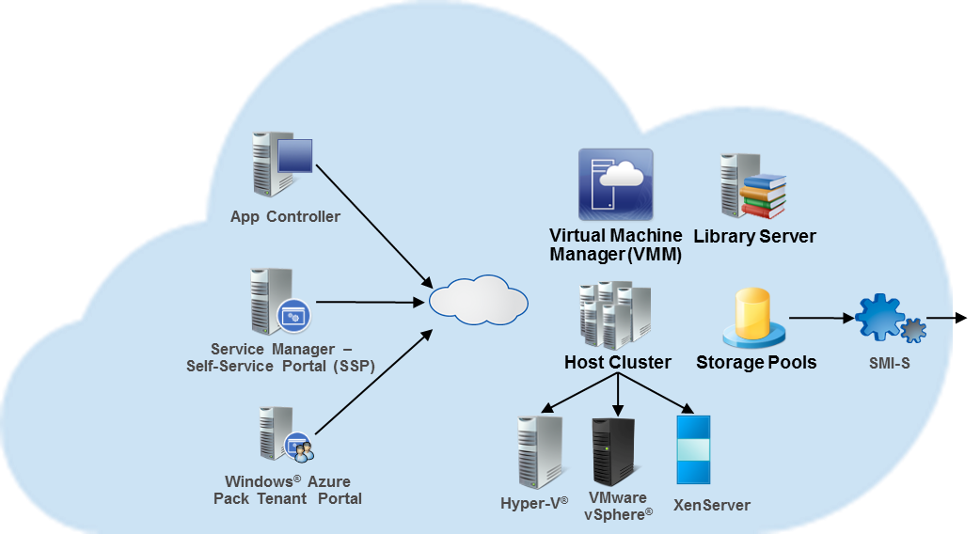



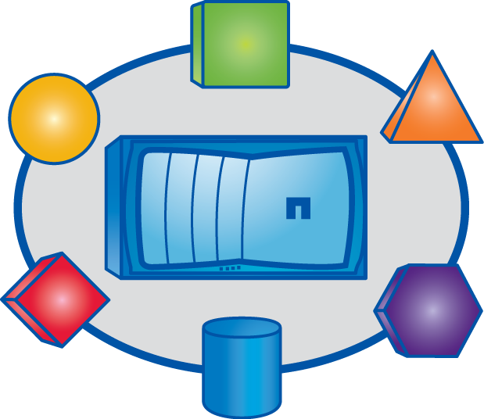



Putting It All Together (Cont.)
Embedded Data Security
Integrated Data Protection
Secure Multi-Tenancy
Continuous Operations
Intelligent Caching
Seamless Scaling
Storage Efficiency
Unified Architecture
Deduplication
Flash Accelerated
Service Automation Analytics

Slide 19
Cloud service delivery Aligning the needs of business and IT
Agility
Business
Turbulence
Application development and deployment
Control
IaaS
PaaS
Flexibility and choice
Cloud service delivery
IT
Stability
Management and automation
Compute
Storage
Network

Slide 20
Azure Pack for cloud service delivery
IT admin
Business
ADMIN PORTAL
CUSTOMER PORTAL
Resource clouds
Automation
Billing
Tenant management
Hosting plan
PaaS Websites
IaaS Virtual machines
PaaS Service bus
IaaS Network
PaaS Database
Windows Server and System Center
Physical hardware (compute, storage, networking)

Slide 21
Transform the datacenter
Build a
software-defined foundation
Automate and secure your infrastructure
Extend
to the cloud
on demand
Microsoft Azure Windows Server Microsoft System Center

Slide 22
Connected hybrid services
Datacenter
Microsoft Azure
Services
Azure Pack
Services
Consistency
Connectivity
Code
Infrastructure
System Center
Windows Server
Hyper-V
Infrastructure

Slide 23


Compute
Hyper-V enables mobility of virtual machines between clouds
Hyper-V virtual machine
Linux
Service provider datacenter
Customer datacenter
Key features include:
Hyper-V virtual machine mobility across clouds
Linux and Windows Server guest OS
Bring cloud virtual machines back on-premises
Service-provider-cloud friendly

Slide 24
Networking Enable seamless datacenter extensions
Microsoft Azure
Hybrid connectivity between sites
Extend your datacenter to Azure
VPN
Private
Public internet
ExpressRoute
Key features include:
Site to site gateway
Higher throughput
Border Gateway Protocol (BGP) routing
ExpressRoute for secure Azure connectivity
Multiprotocol Label Switching (MPLS) awareness

Slide 25
Identity
Access across clouds
Microsoft Azure Active Directory
Service provider
On-premises infrastructure
Windows Server Active Directory
Key features include:
Single identity across clouds
Integrate with existing Active Directory

Slide 26

Business continuity On-premises to on-premises protection with Azure Site Recovery
Microsoft Azure Site Recovery
Microsoft Azure Site Recovery
Communication Channel
Download InMage Scout
InMage Scout
InMage Scout
Replication and orchestration channel: InMage replication
Replication channel: Hyper-V Replica or SAN replication
Windows Server
Primary site
Recovery site
Windows Server
VMware/Physical
Primary site
Recovery site
VMware
Key features include:
Automated VM protection and replication
Remote health monitoring
Customizable recovery plans
Integration with existing investments
No-impact recovery plan testing
Orchestrated recovery of tiered applications
Support for heterogeneous environments

Slide 27
Business continuity On-premises to Microsoft Azure protection with Azure Site Recovery
Microsoft Azure Site Recovery
Microsoft Azure Site Recovery
Orchestration and replication
Orchestration and replication
InMage Scout
2015
Primary site
Windows Server
Primary site
VMware/Physical
Key features include:
Use Azure as your DR site
Automated VM protection and replication
Remote health monitoring
Customizable recovery plans
No-impact recovery plan testing
Orchestrated recovery of tiered applications
Support for heterogeneous environments

Slide 28
Hybrid management Extending management with the cloud
Operations: Intelligent workload and platform monitoring across hybrid environments.
Automation: Rich workflow delivering by single automation solution across clouds.
Insight: Cloud based operations management and intelligence service to gain deeper insights into environments.
Microsoft Azure
System Center
Key features include:
Azure and third party cloud monitoring
Office 365 monitoring
Rich automation and workflow consistency
Centralized ingestion of log data from multiple sources
Fast Search to explore, investigate and fix incidents quickly
Ready-made intelligence packs providing actionable insight
DevOps integration and cloud-based application monitoring

Slide 29
Microsoft cloud platform
The platform for hybrid cloud enables IT to:
Customer
Empower enterprise mobility
Create the Internet of your things
Enable application innovation
Unlock insights on any data
Transform the datacenter
CONSISTENT PLATFORM
Service Provider
Microsoft
Development
Management
Identity
Data
Virtualization

Slide 30

© 2014 Microsoft Corporation. All rights reserved. Microsoft, Windows, Windows Vista and other product names are or may be registered trademarks and/or trademarks in the U.S. and/or other countries.
The information herein is for informational purposes only and represents the current view of Microsoft Corporation as of the date of this presentation. Because Microsoft must respond to changing market
conditions, it should not be interpreted to be a commitment on the part of Microsoft, and Microsoft cannot guarantee the accuracy of any information provided after the date of this presentation.
MICROSOFT MAKES NO WARRANTIES, EXPRESS, IMPLIED OR STATUTORY, AS TO THE INFORMATION IN THIS PRESENTATION.

